Slide 1




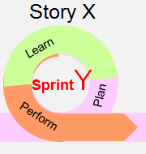









Timeline for Delivery
2019
July
August
September
October
November
December
January
February
RFP
July 17th RFI
Contracting
Mobilisation & Planning
Transition
Services Commencement
- Start T&C’s in parallel – leverage existing
- Planning includes transition order of Applications
Transition
Execution
3
Application and Process Documentation
Restart Transition Planning
New IBM Service Delivery Model
Service Transition
2
Joint Verification
Knowledge Transfer to IBM resources

